Slide 1
Regression and Classification with Neural Networks
Note to other teachers and users of these slides. Andrew would be delighted if you found this source material useful in giving your own lectures. Feel free to use these slides verbatim, or to modify them to fit your own needs. PowerPoint originals are available. If you make use of a significant portion of these slides in your own lecture, please include this message, or the following link to the source repository of Andrew’s tutorials: http://www.cs.cmu.edu/~awm/tutorials . Comments and corrections gratefully received.
Andrew W. Moore Professor
School of Computer Science Carnegie Mellon University
www.cs.cmu.edu/~awm awm@cs.cmu.edu
412-268-7599
Copyright © 2001, 2003, Andrew W. Moore
Sep 25th, 2001
Linear Regression
DATASET
inputs | outputs
x₁ = 1 | y₁ = 1
x₂ = 3 | y₂ = 2.2
x₃ = 2 | y₃ = 2
x₄ = 1.5 | y₄ = 1.9
x₅ = 4 | y₅ = 3.1
↑
w
← 1 →↓
Linear regression assumes that the expected value of the output given an input, E[y|x], is linear.
Simplest case: Out(x) = wx for some unknown w. Given the data, we can estimate w.
Neural Networks: Slide 2

Slide 2
1-parameter linear regression
Assume that the data is formed by
y_{i} = wx_{i} + noise_{i}
where…
the noise signals are independent
the noise has a normal distribution with mean 0 and unknown variance σ²
P(y|w,x) has a normal distribution with
mean wx
variance σ²
Copyright © 2001, 2003, Andrew W. Moore
Neural Networks: Slide 3
Bayesian Linear Regression
P(y|w,x) = Normal (mean wx, var σ²)
We have a set of datapoints (x₁,y₁) (x₂,y₂) … (x_{n},y_{n}) which are EVIDENCE about w.
We want to infer w from the data.
P(w|x₁, x₂, x₃,…x_{n}, y₁, y₂…y_{n})
You can use BAYES rule to work out a posterior distribution for w given the data.
Or you could do Maximum Likelihood Estimation
Neural Networks: Slide 4

Slide 3
Maximum likelihood estimation of w
Asks the question:
“For which value of w is this data most likely to have happened?”
<=>
For what w is
P(y₁, y₂…y_{n} |x₁, x₂, x₃,…x_{n}, w) maximized?
<=>
For what w is
n
∏P(y_{i} w, x_{i} ) maximized
i=1
Copyright © 2001, 2003, Andrew W. Moore
Neural Networks: Slide 5
For what w is
n
∏ P ( y_{i} w, x_{i} )
maximized?
i =1
For what w is
n
∏
i=1
For what w is
n
∑
i =1
For what w is
1
y −wx
2
exp(− (
i i
) ) maximized?
2 σ
1 ⎛ y − wx
⎞ 2
−
⎜ i i ⎟
maximized?
2 ⎝ σ
⎠
2
∑ (y _{i} − wx _{i} ) minimized?
i =1
n
Neural Networks: Slide 6

Slide 4
Linear Regression
The maximum likelihood w is the one that minimizes sum- of-squares of residuals
E(w) _{w}
Ε = (y − wx )
∑ i i
2
i
(2 x y )w+ ( )
∑ i
2
∑ i i ∑ i
2
2
= y −
x w
i
We want to minimize a quadratic function of w.
Copyright © 2001, 2003, Andrew W. Moore Neural Networks: Slide 7
Linear Regression
Easy to show the sum of squares is minimized when
_{w =} ∑ ^{x}i ^{y}i
∑ i
2
x
The maximum likelihood
model is
Out(x) = wx
We can use it for prediction
Neural Networks: Slide 8

Slide 5
Linear Regression Easy to show the sum of squares is minimized when _{∑ x y} p(w) _{w =} i i _{w} _{∑ x} 2 ^{i} Note: In Bayesian stats you’d have
The maximum likelihood ^{model is} Out(x) = wx We can use it for prediction | ended up with a prob dist of w And predictions would have given a prob dist of expected output Often useful to know your confidence. Max likelihood can give some kinds of confidence too.
Copyright © 2001, 2003, Andrew W. Moore Neural Networks: Slide 9
Multivariate Regression
What if the inputs are vectors?
₃ .
. 4
6 .
. ₅
. 8
. 10
2-d input example
x₂
x₁
Dataset has form
x₁ x₂ x₃
.:
.
x_{R}
y₁ y₂ y₃
:
y_{R}
Neural Networks: Slide 10

Slide 6
Multivariate Regression
Write matrix X and Y thus:
⎡.....x₁.....⎤
...
x ... x
M ⎥ ⎢ M ⎥
x ... x ⎥
Rm ⎦ ⎣ R ⎦
^{⎡ x}11 ^{x}12
^{x}1m ⎤
⎡ y₁ ⎤
⎢.....x .....⎥
⎢ _{x}
⎥ ⎢ _{y} ⎥
⎥ ₌ ⎢
2m _{⎥ y = ⎢} 2 ⎥
x = ⎢
2
⎢ M ⎥ ⎢
21
22
⎢
⎥ ⎢_{x}
⎢ _{y} ⎥
⎣.....x_{R} .....⎦
⎣ R1
R 2
(there are R datapoints. Each input has m components) The linear regression model assumes a vector w such that
Out(x) = w^{T}x = w₁x[1] + w₂x[2] + ….w_{m}x[D] The max. likelihood w is w = (X^{T}X) ⁻¹(X^{T}Y)
Copyright © 2001, 2003, Andrew W. Moore
Neural Networks: Slide 11
Multivariate Regression
Write matrix X and Y thus:
⎡.....x₁.....⎤
...
x ... x
M ⎥ ⎢ M ⎥
x ... x ⎥
Rm ⎦ ⎣ R ⎦
^{⎡ x}11 ^{x}12
^{x}1m ⎤
⎡ y₁ ⎤
⎢.....x .....⎥
⎢ _{x}
⎥ ⎢ _{y} ⎥
⎥ ₌ ⎢
2m _{⎥ y = ⎢} 2 ⎥
x = ⎢
2
⎢ M ⎥ ⎢
21
22
⎢
⎥ ⎢_{x}
⎢ _{y} ⎥
⎣.....x_{R} .....⎦
⎣ R1
R 2
(there are R datapoints. Each input
The linear regression model assumes a vector w such that Out(x) = w^{T}x = w₁x[1] + w₂x[2] + ….w_{m}x[D]
The max. likelihood w is w = (X^{T}X) ⁻¹(X^{T}Y)
IMPORTANT EXERCISE: PROVE IT !!!!!
has m components)
Neural Networks: Slide 12

Slide 7
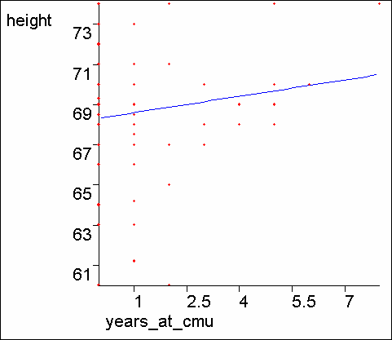
Multivariate Regression (con’t)
The max. likelihood w is w = (X^{T}X)⁻¹(X^{T}Y)
R
X^{T}X is an m x m matrix: i,j’th elt is ∑^{xkixkj}
k=1
R
∑^{x}ki ^{y}k
k=1
X^{T}Y is an m-element vector: i^{’th} elt
Copyright © 2001, 2003, Andrew W. Moore
Neural Networks: Slide 13
What about a constant term?
We may expect linear data that does not go through the origin.
Statisticians and Neural Net Folks all agree on a simple obvious hack.
Can you guess??
Neural Networks: Slide 14

Slide 8
The constant term
The trick is to create a fake input “X₀” that always takes the value 1
X₁ | X₂ | Y
2 | 4 | 16
3 | 4 | 17
5 | 5 | 20
X₀ | X₁ | X₂ | Y
1 | 2 | 4 | 16
1 | 3 | 4 | 17
1 | 5 | 5 | 20
Before:
Y=w₁X₁+ w₂X₂
…has to be a poor model
After:
Y= w₀X₀+w₁X₁+ w₂X₂
= w₀+w₁X₁+ w₂X₂
…has a fine constant term
Neural Networks: Slide 15
In this example, You should be able to see the MLE w₀
, w₁ and w₂ by inspection
Copyright © 2001, 2003, Andrew W. Moore
Regression with varying noise
Suppose you know the variance of the noise that was added to each datapoint.
x_{i} | y_{i} | _{σ} 2 i
½ | ½ | 4
1 | 1 | 1
2 | 1 | 1/4
2 | 3 | 4
3 | 2 | 1/4
y=3
σ=2
y=2
σ=1/2
y=1
σ=1
σ=1/2
σ=2
y=0
x=0
x=1
x=2
x=3
y ~ N (wx ,σ )
Assume
2
What’s the MLE
i i i
estimate of w?
Neural Networks: Slide 16

Slide 9
MLE estimation with varying noise
argmax log p( y , y ,..., y | x , x ,..., x ,σ ,σ ,...,σ , w) =
1 2 R 1 2 R 1 2
2 2 2
w
R
R
( y − wx )
2
Assuming i.i.d. and then plugging in equation for Gaussian and simplifying.
argmin ∑
w
i i
=
i=1
σ
2
i
⎛
R
x_{i} ( y_{i} − wx_{i} )
⎞
Setting dLL/dw equal to zero
⎜ w such that ∑
= 0⎟ =
⎠
⎝
i=1
σ
2
i
⎛ R
∑ i i 
x y ⎞
Trivial algebra
σ
2
 i
⎠
i=1
⎛ R
∑ i 
x² ⎞
σ
2
⎝ i ⎠
Copyright © 2001, 2003, Andrew W. Moore
i=1
Neural Networks: Slide 17
This is Weighted Regression
We are asking to minimize the weighted sum of squares
R
( y_{i} − wx_{i} )
2
y=3
σ=2
argmin ∑
w
i=1
σ
2
i
y=2
σ=1/2
y=1
σ=1
σ=1/2
σ=2
y=0
x=0
x=1
x=2
x=3
1
where weight for i’th datapoint is
σ
2
i
Neural Networks: Slide 18

Slide 10
Weighted Multivariate Regression
The max. likelihood w is w = (WX^{T}WX)⁻¹(WX^{T}WY)
R
∑
k =1
^{x}ki ^{x}kj
(WX^{T}WX) is an m x m matrix: i,j’th elt is
σ
2
i
(WX^{T}WY) is an m-element vector: i^{’th} elt
R
^{x}ki ^{y}k
∑
k =1
σ
2
i
Copyright © 2001, 2003, Andrew W. Moore
Neural Networks: Slide 19
Non-linear Regression
Suppose you know that y is related to a function of x in such a way that the predicted values have a non-linear dependence on w, e.g:
x_{i} | y_{i}
½ | ½
1 | 2.5
2 | 3
3 | 2
3 | 3
y=3
y=2
y=1
y=0
x=0
x=1
x=2
x=3
w + x ,σ )
Assume y ~ N (
2
What’s the MLE
i
i
estimate of w?
Neural Networks: Slide 20

Slide 11

Non-linear MLE estimation
argmax log p( y₁ , y₂ ,..., y_{R} | x₁ , x₂ ,..., x_{R} ,σ , w) =
w
argmin
w
R
(y − w + x ) =
Assuming i.i.d. and then plugging in equation for Gaussian and simplifying.
∑ i
i
2
i=1
⎛
R
y_{i} − w + x_{i} w + x_{i}
⎞
Setting dLL/dw equal to zero
⎜ w such that ∑
= 0⎟ =
⎜
⎟
⎝
i=1
⎠
Copyright © 2001, 2003, Andrew W. Moore
Neural Networks: Slide 21
Non-linear MLE estimation
argmax log p( y₁ , y₂ ,..., y_{R} | x₁ , x₂ ,..., x_{R} ,σ , w) =
w
R
(y − )
2
Assuming i.i.d. and then plugging in equation for Gaussian and simplifying.
argmin ∑
w + x =
w
i=1
i i
⎛
R
y_{i} − w + x_{i} w + x_{i}
⎞
⎟
Setting dLL/dw equal to zero
⎜ w such that ∑
= 0⎟ =
⎜
⎝
i=1
⎠
We’re down the algebraic toilet
So guess what
we do?
Neural Networks: Slide 22

Slide 12
Non-linear MLE estimation
argmax log p( y₁ , y₂ ,..., y_{R} | x₁ , x₂ ,..., x_{R} ,σ , w) =
w
Common (but not only) approa^{R}ch:
argmin
(y − w + x ) =
Assuming i.i.d. and then plugging in equation for Gaussian and simplifying.
Numerical Solutions:
∑ i
i
2
w
i=1
Line Search
Simulated A⎛nnealing
Gradient Descent
•
Levenberg Marquart
Newton’s Method
R
y − w + x
⎞
Setting dLL/dw equal to zero
⎜
∑
i=1
i i
w + x_{i}
⎟
⎜
w such that
= 0 =
Conjugate G⎝radient
⎟
⎠
We’re down the algebraic toilet
Also, special purpose statistical- optimization-specific tricks such as
E.M. (See Gaussian Mixtures lecture
for introduction)
Copyright © 2001, 2003, Andrew W. Moore Neural Networks: Slide 23
So guess what
we do?
GRADIENT DESCENT
Suppose we have a scalar function _{f(w): ℜ→ℜ}
We want to find a local minimum. Assume our current weight is w
GRADIENT DESCENT RULE:
w ← w−η ∂ f (w)
∂w
η is called the LEARNING RATE. A small positive number, e.g. η = 0.05
Neural Networks: Slide 24

Slide 13
GRADIENT DESCENT
Suppose we have a scalar function _{f(w): ℜ→ℜ}
We want to find a local minimum. Assume our current weight is w
GRADIENT DESCENT RULE:
w ← w−η ∂ f (w)
∂w
Recall Andrew’s favorite default value for anything
η is called the LEARNING RATE. A small positive number, e.g. η = 0.05
QUESTION: Justify the Gradient Descent Rule
Copyright © 2001, 2003, Andrew W. Moore Neural Networks: Slide 25
Gradient Descent in “m” Dimensions
Given f(w) : ℜ^{m} → ℜ
⎛ ∂ f (w)⎞
⎜ ∂w
⎟
∇f(w) = ^{⎜ 1} M
⎜
⎟ points in direction of steepest ascent.
⎜ ∂
⎟
f (w)⎟
⎜ ∂w
⎟
⎝ ⎠
m
^{∇f(w)} is the gradient in that direction GRADIENT DESCENT RULE: w ←w-η∇f(w)
Equivalently
∂
….where w_{j} is the jth weight
“just like a linear feedback system”
w ← w - η f (w)
j j
∂w
j
Neural Networks: Slide 26

Slide 14
What’s all this got to do with Neural Nets, then, eh??
For supervised learning, neural nets are also models with vectors of w parameters in them. They are now called weights.
As before, we want to compute the weights to minimize sum- of-squared residuals.
Which turns out, under “Gaussian i.i.d noise” assumption to be max. likelihood.
Instead of explicitly solving for max. likelihood weights, we use GRADIENT DESCENT to SEARCH for them.
_{“Wh}y?” you ask, a querulous expression in your eyes.
“Aha!!” I reply: “We’ll see later.”
Copyright © 2001, 2003, Andrew W. Moore
Neural Networks: Slide 27
Linear Perceptrons
They are multivariate linear models:
Out(x) = w^{T}x
And “training” consists of minimizing sum-of-squared residuals by gradient descent.
Ε = ∑ (Out (x )− y
₎2
k
k
₎2
k
= ∑ (w^{Τ} x − y
k k
k
QUESTION: Derive the perceptron training rule.
Neural Networks: Slide 28

Slide 15
Linear Perceptron Training Rule
R
∑ k k
T 2
E = ( y − w x )
k =1
Gradient descent tells us we should update w thusly if we wish to minimize E:
w ← w - η ^{∂E}
j j
∂w
j
So what’s
∂E
∂w ?
j
Copyright © 2001, 2003, Andrew W. Moore
Neural Networks: Slide 29
Linear Perceptron Training Rule
R
∑ k k
∂E _{= ∑}^{R} ∂
T 2
E = ( y − w x )
( y − w^{T} x )²
k =1
Gradient descent tells us we should update w thusly if we wish to minimize E:
∂w
∂w
k k
R
j k =1 j
∂
= ∑ 2( y − w x ) ( y − w x )
T
T
k =1
k k
∂w_{j}
k k
R
= −2∑δ
k =1
∂
^{k} ∂w
w^{T} x
j
k
w ← w - η ^{∂E}
…where…
T
j j
∂w
δ = y − w x
j
R
= −2∑δ
k =1
∂
^{k} ∂w
m
k k
k
∑ i ki
w x
∂E
j i=1
So what’s
R
∂w ?
= −2∑
^{δ}k ^{x}kj
j
k =1
Neural Networks: Slide 30

Slide 16
Linear Perceptron Training Rule
R
∑ k k
T 2
E = ( y − w x )
k =1
Gradient descent tells us we should update w thusly if we wish to minimize E:
w ← w - η ^{∂E}
R
j j
∂w
w ← w + 2η∑δ x
…where…
j
j j k kj
^{∂E} = −2∑^{R} δ x
k =1
∂w
k kj
We frequently neglect the 2 (meaning we halve the learning rate)
Neural Networks: Slide 31
j k =1
Copyright © 2001, 2003, Andrew W. Moore
The “Batch” perceptron algorithm
Randomly initialize weights w₁ w₂ … w_{m}
Get your dataset (append 1’s to the inputs if you don’t want to go through the origin).
3) for i = 1 to R
δ := y − w^{Τ}x
i i
i
4) for j = 1 to m
R
j j ∑ i ij
w ← w +η δ x
∑ i
i=1
5) if
δ
2
stops improving then stop. Else loop
back to 3.
Neural Networks: Slide 32

Slide 17
δ ← y − w x
Τ
i i i
w_{j} ← w_{j} + ηδ _{i} x_{ij}
A RULE KNOWN BY MANY NAMES
The LMS Rule
The Widrow Hoff rule
The delta rule
Classical
The adaline rule
conditioning
Copyright © 2001, 2003, Andrew W. Moore
Neural Networks: Slide 33
If data is voluminous and arrives fast
Input-output pairs (x,y) come streaming in very quickly. THEN
Don’t bother remembering old ones. Just keep using new ones.
observe (x,y)
δ ← y − w^{Τ}x
∀j w_{j} ← w_{j} + η δ x _{j}
Neural Networks: Slide 34

Slide 18
Gradient Descent vs Matrix Inversion for Linear Perceptrons
GD Advantages (MI disadvantages):
•
•
•
GD Disadvantages (MI advantages):
•
•
•
•
•
Copyright © 2001, 2003, Andrew W. Moore
Neural Networks: Slide 35
Gradient Descent vs Matrix Inversion for Linear Perceptrons
GD Advantages (MI disadvantages):
Biologically plausible
With very very many attributes each iteration costs only O(mR). If fewer than m iterations needed we’ve beaten Matrix Inversion
More easily parallelizable (or implementable in wetware)?
GD Disadvantages (MI advantages):
It’s moronic
It’s essentially a slow implementation of a way to build the XTX matrix and then solve a set of linear equations
If m is small it’s especially outageous. If m is large then the direct matrix inversion method gets fiddly but not impossible if you want to be efficient.
Hard to choose a good learning rate
Matrix inversion takes predictable time. You can’t be sure when gradient descent will stop.
Neural Networks: Slide 36

Slide 19
Gradient Descent vs Matrix Inversion for Linear Perceptrons
GD Advantages (MI disadvantages):
Biologically plausible
With very very many attributes each iteration costs only O(mR). If fewer than m iterations needed we’ve beaten Matrix Inversion
More easily parallelizable (or implem^{B}e^{u}n^{t}ta^{w}bl^{e}e^{’l}i^{l}n wetware)?
GD Disadvantages (MI^{so}aºd^{n}v^{s}a^{ee}nt^{th}aªg^{t} es):
GD
It’s moronic
It’s essentially a slow implehmaesntaantioinmopfoartwaanytteoxbturiald the XTX matrix
and then solve a set of linear e_{tr}q_{i}u_{c}a_{k}ti_{u}on_{p}s _{its sleeve}
If m is small it’s especially outageous. If m is large then the direct matrix inversion method gets fiddly but not impossible if you want to be efficient.
Hard to choose a good learning rate
Matrix inversion takes predictable time. You can’t be sure when gradient descent will stop.
Copyright © 2001, 2003, Andrew W. Moore Neural Networks: Slide 37
Perceptrons for Classification
What if all outputs are 0’s or 1’s ?
or
We can do a linear fit.
Our prediction is 0 if out(x)≤1/2
1 if out(x)>1/2
WHAT’S THE BIG PROBLEM WITH THIS???
Neural Networks: Slide 38

Slide 20
Perceptrons for Classification
What if all outputs are 0’s or 1’s ?
or
We can do a linear fit.
Our prediction is 0 if out(x)≤½
1 if out(x)>½
WHAT’S THE BIG PROBLEM WITH THIS???
Blue = Out(x)
Copyright © 2001, 2003, Andrew W. Moore
Neural Networks: Slide 39
Perceptrons for Classification
What if all outputs are 0’s or 1’s ?
or
We can do a linear fit.
Our prediction is 0 if out(x)≤½
1 if out(x)>½
Blue = Out(x)
Green = Classification
Neural Networks: Slide 40

Slide 21
Classification with Perceptrons I
∑ i
(y − w x ) .
Don’t minimize
Τ
i
2
Minimize number of misclassifications instead. [Assume outputs are
+1 & -1, not +1 & 0]
∑ i
(y − Round (w x )
Τ
i
where Round(x) =
-1 if x<0
1 if x≥0
NOTE: CUTE & NON OBVIOUS WHY
THIS WORKS!!
The gradient descent rule can be changed to: if (x_{i},y_{i}) correctly classed, don’t change
if wrongly predicted as 1 w € w - x_{i}
if wrongly predicted as -1 w € w + x_{i}
Copyright © 2001, 2003, Andrew W. Moore
Neural Networks: Slide 41
Classification with Perceptrons II: Sigmoid Functions
Least squares fit useless
This fit would classify much
better. But not a least squares fit.
Neural Networks: Slide 42

Slide 22
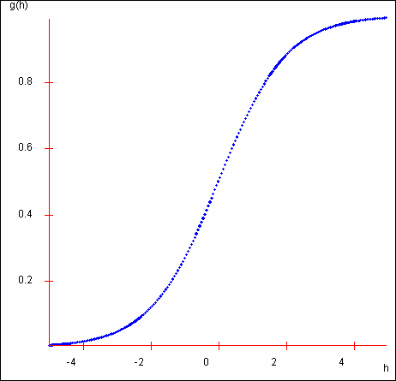
Classification with Perceptrons II: Sigmoid Functions
Least squares fit useless
This fit would classify much better. But not a least squares fit.
SOLUTION:
Instead of Out(x) = w^{T}x
We’ll use Out(x) = g(w^{T}x)
g(x): ℜ→(0,1)
where is a
squashing function
Copyright © 2001, 2003, Andrew W. Moore
Neural Networks: Slide 43
The Sigmoid
g(h) =
1
1+ exp(−h)
Note that if you rotate this curve through 180º centered on (0,1/2) you get the same curve.
i.e. g(h)=1-g(-h)
Can you prove this?
Neural Networks: Slide 44

Slide 23
The Sigmoid
g(h) =
1
1+ exp(−h)
Now we choose w to minimize
R
[y − Out(x )] = [y
g(w x )]
R
∑ ∑
2
2
Τ
i i i
i
i=1 i=1
Copyright © 2001, 2003, Andrew W. Moore Neural Networks: Slide 45
Linear Perceptron Classification Regions
0 0
0
1
1
1
X₂
X₁
Out(x) = g(w^{T}(x,1))
= g(w₁x₁ + w₂x₂ + w₀)
Which region of above diagram classified with +1, and which with 0 ??
We’ll use the model
Neural Networks: Slide 46

Slide 24
Gradient descent with sigmoid on a perceptron
First, notice g' (x) = g(x)(1− g(x))
_{e}− x
Because: g(x) = ¹ so g' (x) =
1+ e^{− x}
⎛⎜1+ e^{− x ⎞}⎟²
⎠
₌ 1 −1− e^{− x} ₌ 1
⎝
1
−1
⎛
1−
1
2
− =
⎞ = −g(x)(1− g(x))
2 − x − x ⎜ − x ⎟
⎛⎜1+ e^{− x ⎞}⎟ ⎛⎜1+ e^{− x ⎞}⎟
1+ e 1+ e ⎝ 1+ e ⎠
Out(x) = g⎛∑ w x ⎞
⎜
⎝ ⎠ ⎝ ⎠
k k ⎟
The sigmoid perceptron update rule:
w_{j} ← w_{j} +η∑δ_{i} g_{i} (1− g_{i} )x_{ij}
⎝ k ⎠
⎛ ⎛
⎞⎞²
Ε = ∑⎜ y_{i} − g⎜∑ w_{k} x_{ik} ⎟⎟
^{i} ⎝ ⎝ ^{k}
⎠⎠
R
∂Ε _{= ∑} ⎛ ⎛∑ ⎞⎞ ∂ ⎛
⎛
⎞⎞
⎜
∑ ^{w}k ^{x}ik ⎟⎟
2⎜ y_{i} − g⎜ w x ⎟⎟ − g⎜
⎠⎟
∂w
j ^{i} ⎝
⎝ k
k ik
∂w
⎝ k
⎠⎠⎜ j
⎛
⎛
⎝
⎠
i=1
⎛ m
⎞
∑ i
∑
⎞⎞ ⎛
⎞ ∂
g_{i} = g∑ w_{j} x_{ij} 
⎜
k ik ∑
k ik ∑ k ik
= − 2 y − g⎜ w x ⎟⎟g ⎜
' w x ⎟ w x
where
i ⎝ ⎝ k ⎠⎠ ⎝ k ⎠ ^{∂w}j k
⎝ j=1
δ_{i} = y_{i} − g_{i}
= ∑− 2δ_{i} g(net_{i} )(1− g(net_{i} ))x_{ij} i
where δ_{i} = y_{i} − Out(x _{i} ) net _{i} = ∑ w_{k} x_{k}
Copyright © 2001, 2003, Andrew W. Moor^{k} e
⎠
Neural Networks: Slide 47
Other Things about Perceptrons
Invented and popularized by Rosenblatt (1962)
Even with sigmoid nonlinearity, correct convergence is guaranteed
Stable behavior for overconstrained and underconstrained problems
Neural Networks: Slide 48

Slide 25
Perceptrons and Boolean Functions
If inputs are all 0’s and 1’s and outputs are all 0’s and 1’s…
Can learn the function x₁ ∧ x₂
X₂
X₁
Can learn the function x₁ ∨ x₂ .
X₂
X₁
Can learn any conjunction of literals, e.g.
x₁ ∧ ~x₂ ∧ ~x₃ ∧ x₄ ∧ x₅
QUESTION: WHY?
Copyright © 2001, 2003, Andrew W. Moore
Neural Networks: Slide 49
Perceptrons and Boolean Functions
Can learn any disjunction of literals
e.g. x₁ ∧ ~x₂ ∧ ~x₃ ∧ x₄ ∧ x₅
Can learn majority function
f(x₁,x₂ … x_{n}) = 1 if n/2 x_{i}’s or more are = 1
0 if less than n/2 x_{i}’s are = 1
What about the exclusive or function? f(x₁,x₂) = x₁ ∀ x₂ =
(x₁ ∧ ~x₂) ∨ (~ x₁ ∧ x₂)
Neural Networks: Slide 50

Slide 26
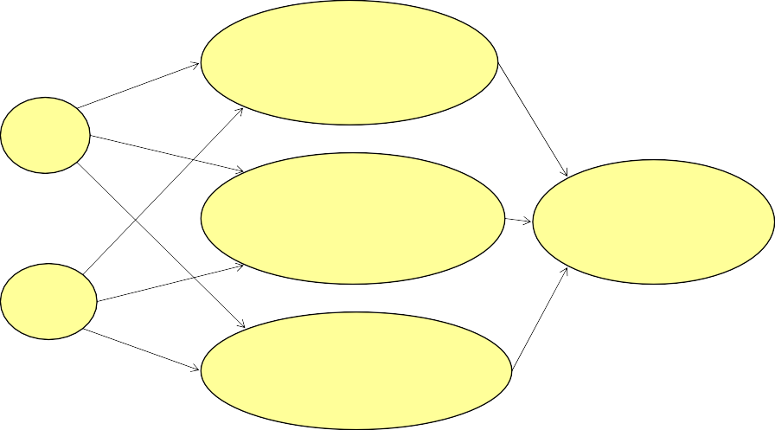
Multilayer Networks
The class of functions representable by perceptrons is limited
⎛ ⎞
Out(x) = g (w x)= g w x
Τ
⎜
∑ j j j
⎟
⎠
⎝
Use a wider representation !
⎛
⎛
⎞⎞
⎜
∑ j ∑ jk jk
⎟⎟
⎠⎠
Out(x) = g W g⎜ w x
This is a nonlinear function Of a linear combination
Of non linear functions
Of linear combinations of inputs
Neural Networks: Slide 51
⎝ j
⎝ k
Copyright © 2001, 2003, Andrew W. Moore
A 1-HIDDEN LAYER NET
^{N}INPUTS ^{= 2 N}HIDDEN ⁼ ³
⎞
⎝ k=1
⎛ ^{N}INS
v₁ = g⎜ ∑w_{1k} x_{k} ⎟
^{w}11
⎠
w₁
x₁
^{w}21
^{w}31
⎛ ^{N}INS
⎞
2 ∑ 2k k
w
⎛ ⎞
v = g⎜ w
x ⎟
^{N} HID
⎝ k=1
⎠
2
Out = g⎜ ∑W_{k} v_{k} ⎟
^{w}12
^{w}22
⎝ k =1 ⎠
x₂
w₃
⎛ ^{N}INS
⎞
^{w}32
v₃ = g⎜ ∑w_{3k} x_{k} ⎟
⎝ k=1
⎠
Neural Networks: Slide 52

Slide 27
OTHER NEURAL NETS
1
x₁ x₂ x₃
2-Hidden layers + Constant Term
“JUMP” CONNECTIONS
x₁
⎛ ^{N}INS
⎞
Out = g⎜ ∑ w
x + ∑W v ⎟
x
2
^{N}HID
⎝ k =1
0 k k
k =1
k k
⎠
Copyright © 2001, 2003, Andrew W. Moore
Neural Networks: Slide 53
Backpropagation
⎛
⎛
⎜
⎝
∑ j ∑ jk k
⎟⎟
Out(x) = g W g
⎜ w x ⎞⎞
j
⎝ k ⎠⎠
Find a set of weights {W_{j} },{w_{jk} } to minimize
∑
(y − Out(x ))
2
i i
i
by gradient descent.
T_{T}h_{h}a_{a}t_{t}’s_{’s}i_{i}t_{t}!!
T_{T}h_{h}a_{a}t_{t}’s_{’s}t_{t}h_{h}e_{e}b_{b}a_{a}c_{c}k_{k}p_{p}r_{r}o_{o}p_{p}a_{a}g_{g}a_{a}t_{t}i_{i}o_{o}n_{n} a_{a}l_{l}g_{g}o_{o}r_{r}i_{i}t_{t}h_{h}m_{m}..
Neural Networks: Slide 54

Slide 28
Backpropagation Convergence
Convergence to a global minimum is not guaranteed.
•In practice, this is not a problem, apparently.
Tweaking to find the right number of hidden units, or a useful learning rate η, is more hassle, apparently.
IMPLEMENTING BACKPROP:  Differentiate Monster sum-square residual   Write down the Gradient Descent Rule  It turns out to be easier & computationally efficient to use lots of local variables with names like h_{j} o_{k} v_{j} net_{i} etc…
Copyright © 2001, 2003, Andrew W. Moore
Neural Networks: Slide 55
Choosing the learning rate
This is a subtle art.
Too small: can take days instead of minutes to converge
Too large: diverges (MSE gets larger and larger while the weights increase and usually oscillate)
Sometimes the “just right” value is hard to find.
Neural Networks: Slide 56

Slide 29
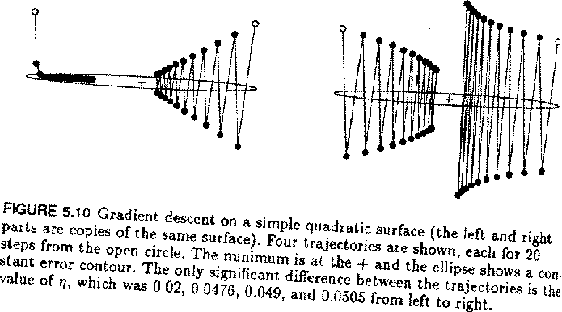
Learning-rate problems
From J. Hertz, A. Krogh, and R.
G. Palmer. Introduction to the Theory of Neural Computation. Addison-Wesley, 1994.
Copyright © 2001, 2003, Andrew W. Moore
Neural Networks: Slide 57
Improving Simple Gradient Descent
Momentum
Don’t just change weights according to the current datapoint. Re-use changes from earlier iterations.
Let ∆w(t) = weight changes at time t.
Let _{− η} ∂Ε
be the change we would make with regular gradient descent.
∂w
Instead we use
∆w(t +1) = −η ^{∂Ε} + α∆w(t )
∂w
w (t + 1) = w (t )+ ∆w (t )
Momentum damps oscillations.
A hack? Well, maybe.
momentum parameter
Neural Networks: Slide 58

Slide 30
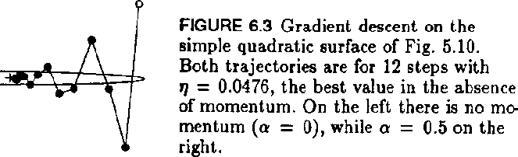
Momentum illustration
Copyright © 2001, 2003, Andrew W. Moore
Neural Networks: Slide 59
Improving Simple Gradient Descent
Newton’s method
_{T} ∂E 1 _{T} ∂² E
3
E(w + h) = E(w) + h h + O(| h | )
∂w ⁺ 2 ^{h} ∂w
2
If we neglect the O(h³) terms, this is a quadratic form
Quadratic form fun facts:
If y = c + b^{T} x - 1/2 x^{T} A x
And if A is SPD Then
x^{opt} = A⁻¹b is the value of x that maximizes y
Neural Networks: Slide 60

Slide 31
Improving Simple Gradient Descent
Newton’s method
_{T} ∂E 1 _{T} ∂² E
3
E(w + h) = E(w) + h h + O(| h | )
∂w ⁺ 2 ^{h} ∂w
2
If we neglect the O(h³) terms, this is a quadratic form
w ← w −
⎡ ∂² E ⎤⁻¹ ∂E
⎢ ⎥
2
∂w ∂w
⎣ ⎦
This should send us directly to the global minimum if the function is truly quadratic.
And it might get us close if it’s locally quadraticish
Copyright © 2001, 2003, Andrew W. Moore
Neural Networks: Slide 61
Improving Simple Gradient Descent
Newton’s method
_{T} ∂E 1 _{T} ∂² E
3
E(w + h) = E(w) + h h + O(| h | )
∂w ⁺ 2 ^{h} ∂w
2
If we neglect the O(h³) terms, this is a quadratic form
BUT (and it’s a big but)…
⎡ ∂² E ⎤⁻¹ ∂E
w ← w −
⎢ ⎥
That second derivative matrix can be
2
∂w ∂w
⎣ ⎦
expensive and fiddly to compute.
This should send us directly to the global minimum if the function is truly quadratic.
And it might get us close if it’s locally quadraticish
we’ll go nuts.
If we’re not already in the quadratic bowl,
Neural Networks: Slide 62

Slide 32
Improving Simple Gradient Descent
Conjugate Gradient
Another method which attempts to exploit the “local quadratic bowl” assumption
But does so while only needing to use ∂E
∂w
and not
∂² E
∂w²
It is also more stable than Newton’s method if the local quadratic bowl assumption is violated.
It’s complicated, outside our scope, but it often works well. More details in Numerical Recipes in C.
Copyright © 2001, 2003, Andrew W. Moore
Neural Networks: Slide 63
BEST GENERALIZATION
Intuitively, you want to use the smallest, simplest net that seems to fit the data.
HOW TO FORMALIZE THIS INTUITION?
Don’t. Just use intuition
Bayesian Methods Get it Right
Statistical Analysis explains what’s going on
Cross-validation
Discussed in the next lecture
Neural Networks: Slide 64

Slide 33
What You Should Know
How to implement multivariate Least- squares linear regression.
Derivation of least squares as max. likelihood estimator of linear coefficients
The general gradient descent rule
Copyright © 2001, 2003, Andrew W. Moore
Neural Networks: Slide 65
What You Should Know
Perceptrons
€ Linear output, least squares
€ Sigmoid output, least squares
Multilayer nets
€ The idea behind back prop
€ Awareness of better minimization methods
Generalization. What it means.
Neural Networks: Slide 66

Slide 34
APPLICATIONS
To Discuss:
What can non-linear regression be useful for?
What can neural nets (used as non-linear regressors) be useful for?
What are the advantages of N. Nets for nonlinear regression?
What are the disadvantages?
Copyright © 2001, 2003, Andrew W. Moore
Neural Networks: Slide 67
Other Uses of Neural Nets…
Time series with recurrent nets
Unsupervised learning (clustering principal components and non-linear versions thereof)
Combinatorial optimization with Hopfield nets, Boltzmann Machines
Evaluation function learning (in reinforcement learning)
Neural Networks: Slide 68

